Slide 1
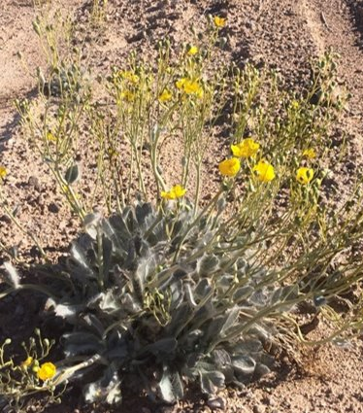



Germination of the Endangered Las Vegas Bear Poppy
Robin Heide
PI mentor: Dr. Anita Antoninka
Doctorate mentor: Lydia Bailey
Northern Arizona University
Hilton Tuscon East – Tuscon, AZ
April 23, 2022

Slide 2
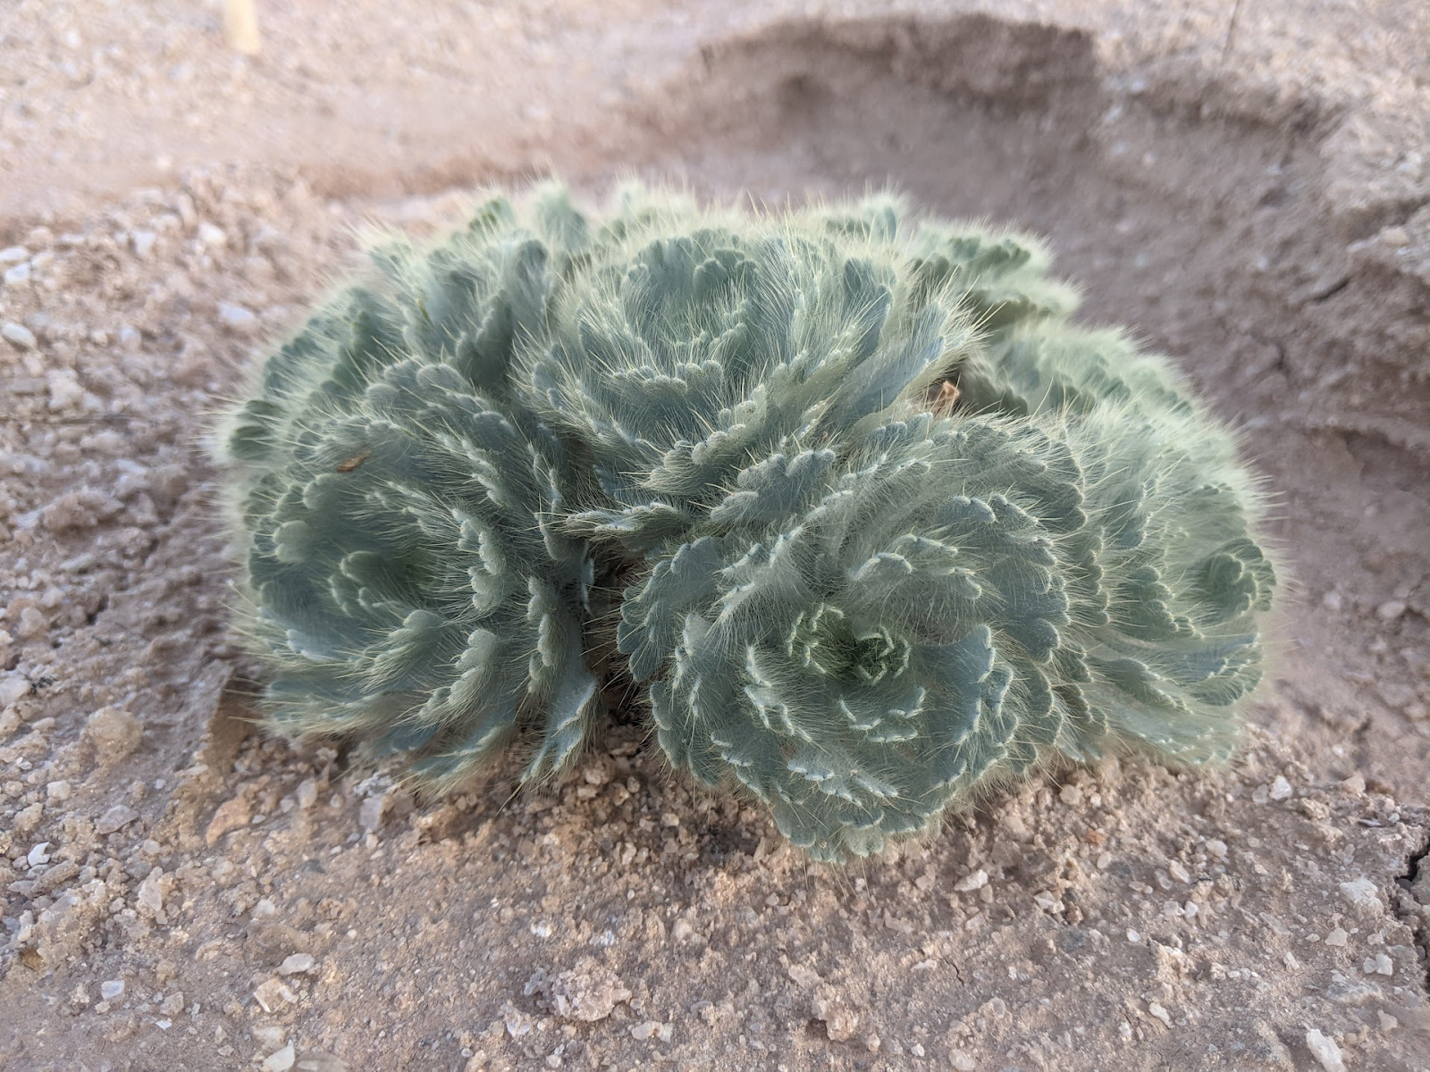
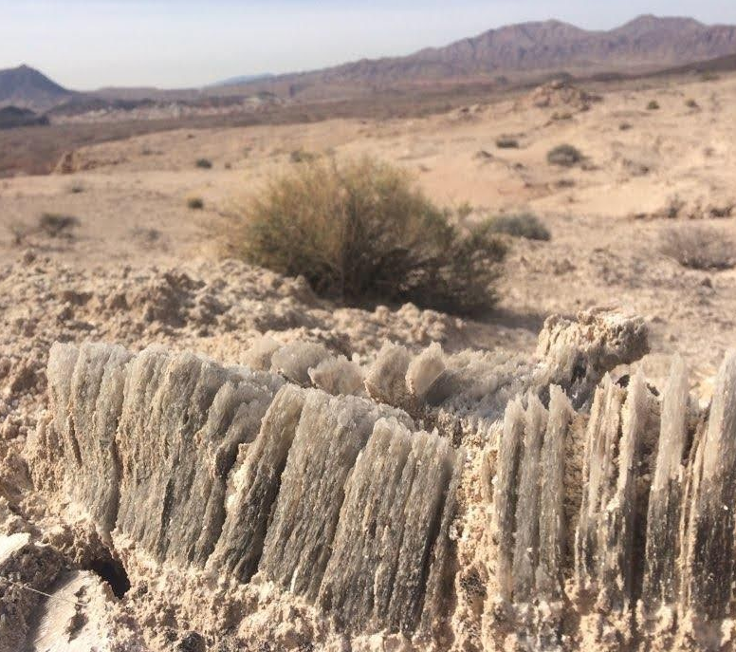
Background
Arctomecon californica
Native to Las Vegas and the Mojave Desert
Endemic to the area; does not grow anywhere else
Gypsum soil and biocrust

Slide 3
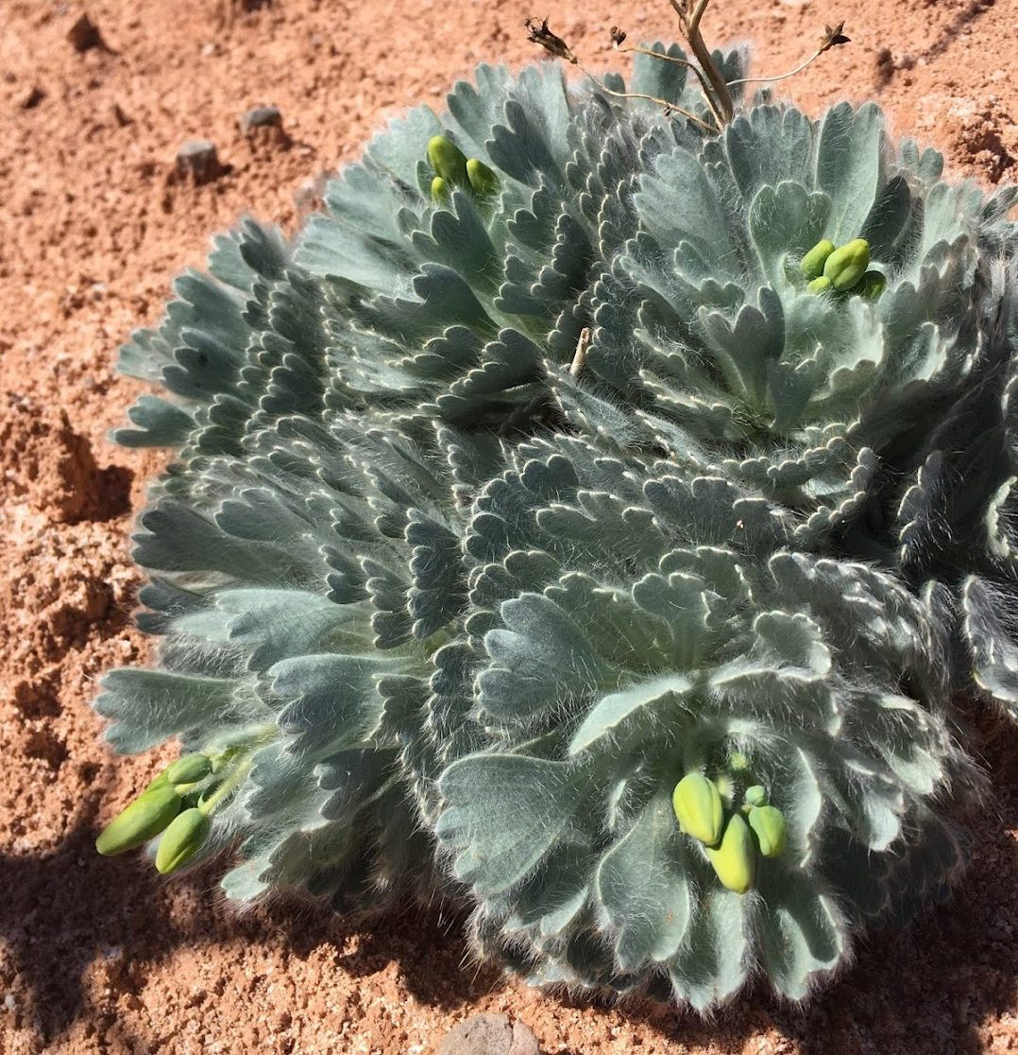
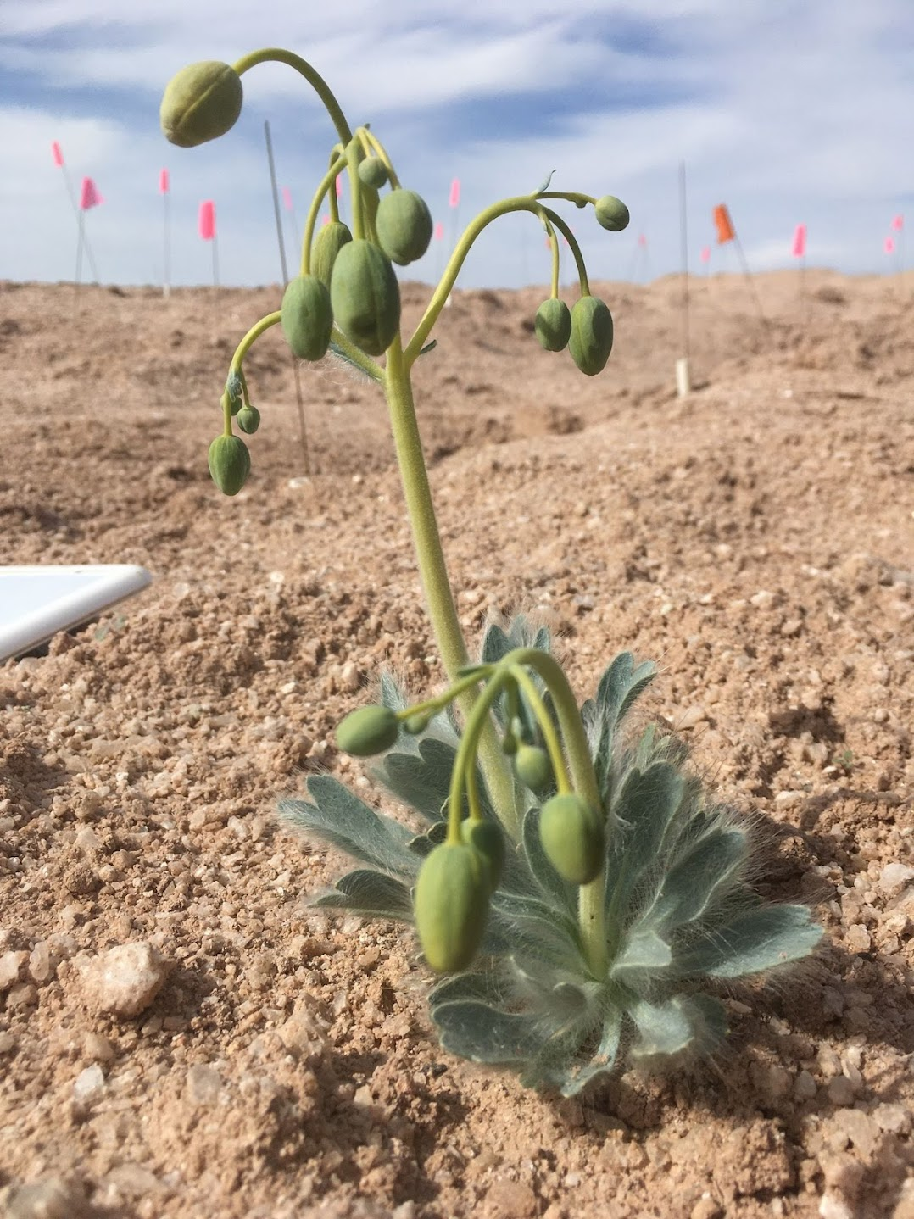
Problems and Questions
Low seasonal germination success rate
Previous studies have had little success, and nobody knows what the seeds take to germinate.
The Bear Poppy is highly endangered
What methods can be used to promote germination and growth of the Bear Poppy seeds?
How will proper scarification methods affect the germination rate?

Slide 4
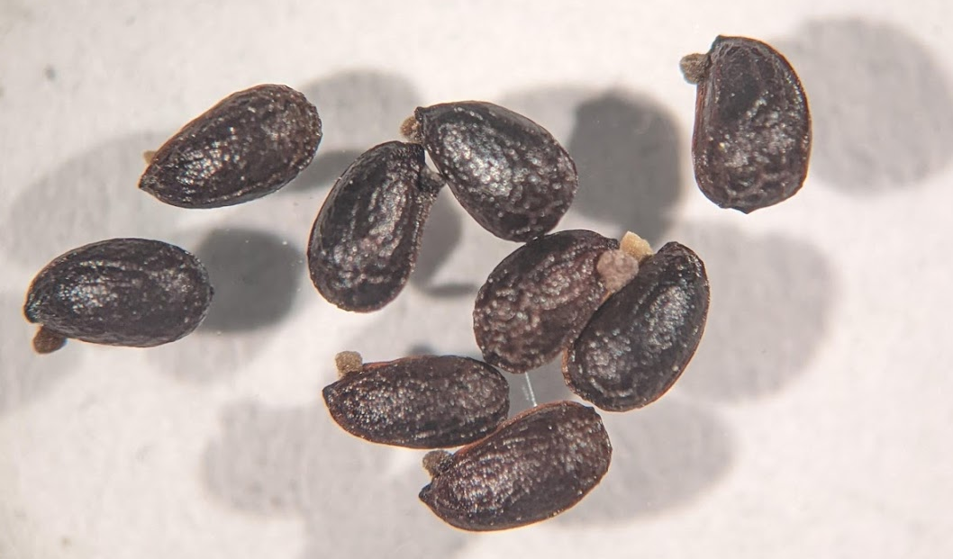
What is scarification?
Scarification is the process of scratching, weakening, and breaking down the coating of the seed in order to speed up and aid in germination.

Slide 5
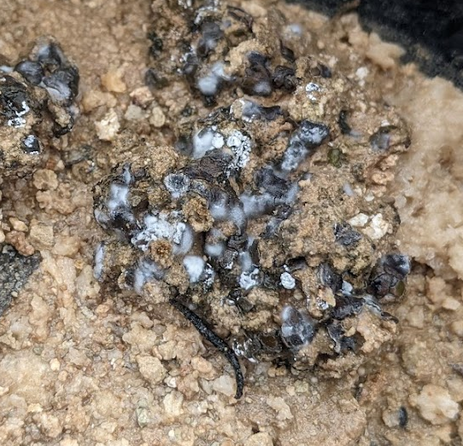
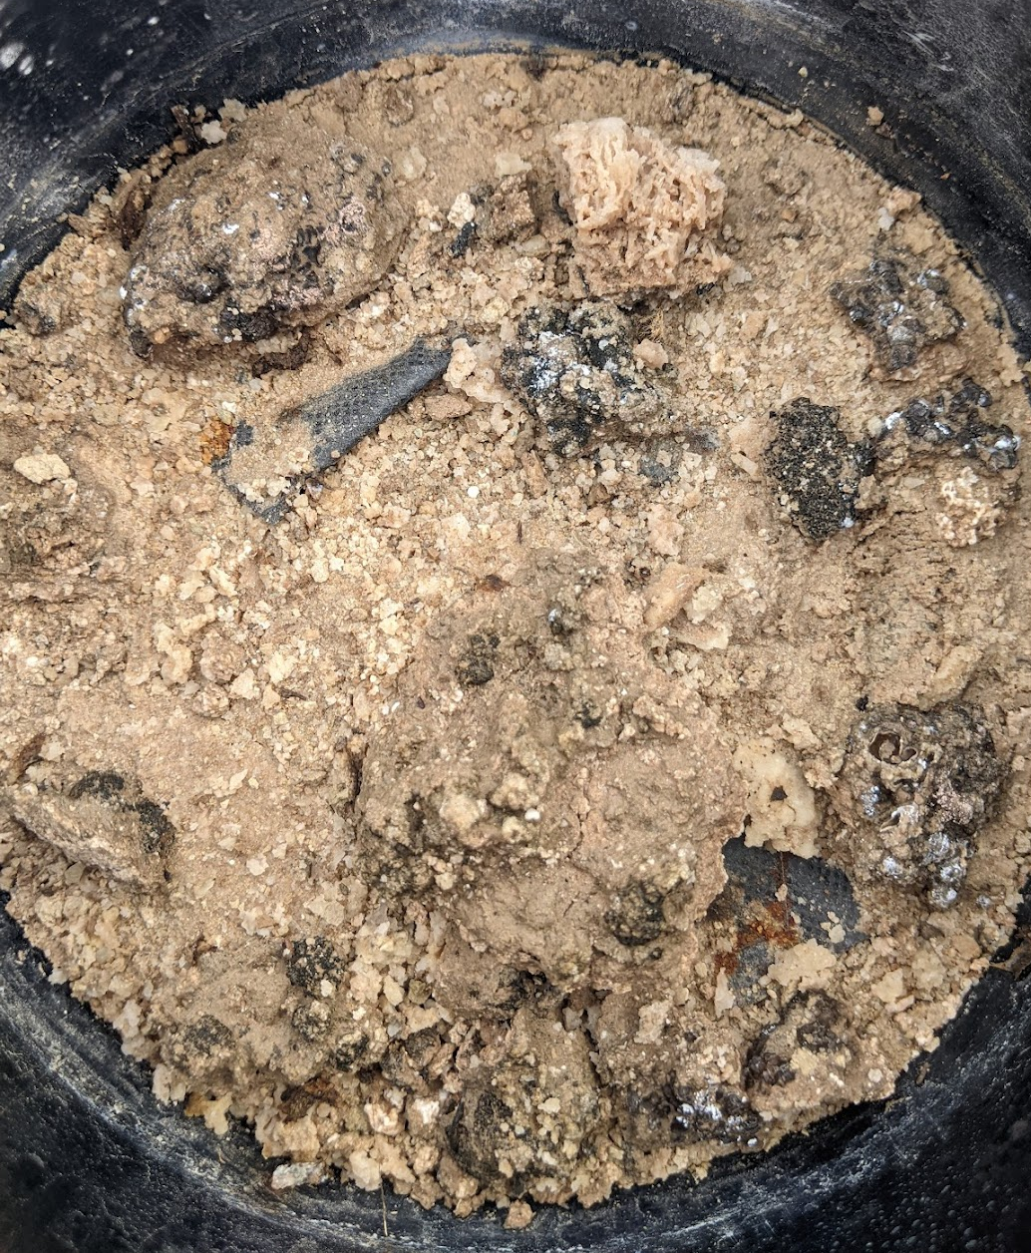
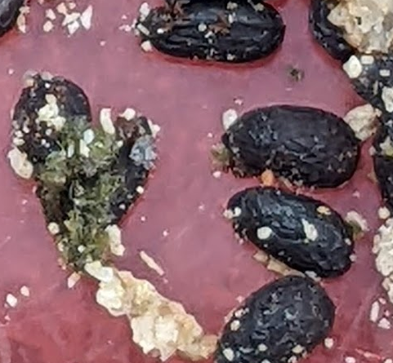

Methods of Scarification
3 different levels of watering to promote mold growth
Bio Scarification
  - Growth chamber for several months to promote the growth of mold on the seeds
Mechanical Scarification
  - Course sandpaper + mechanical shaker to agitate seed coating
Chemical Scarification
  - Concentrated Sulfuric acid soak to break down seed coating as much as possible without killing the seed

Slide 6
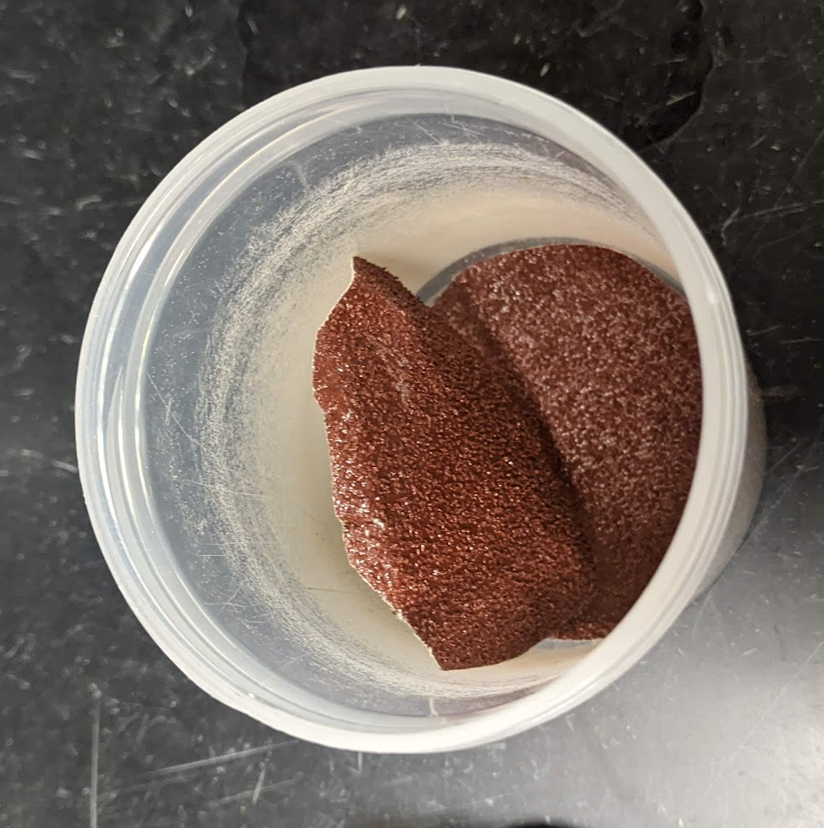
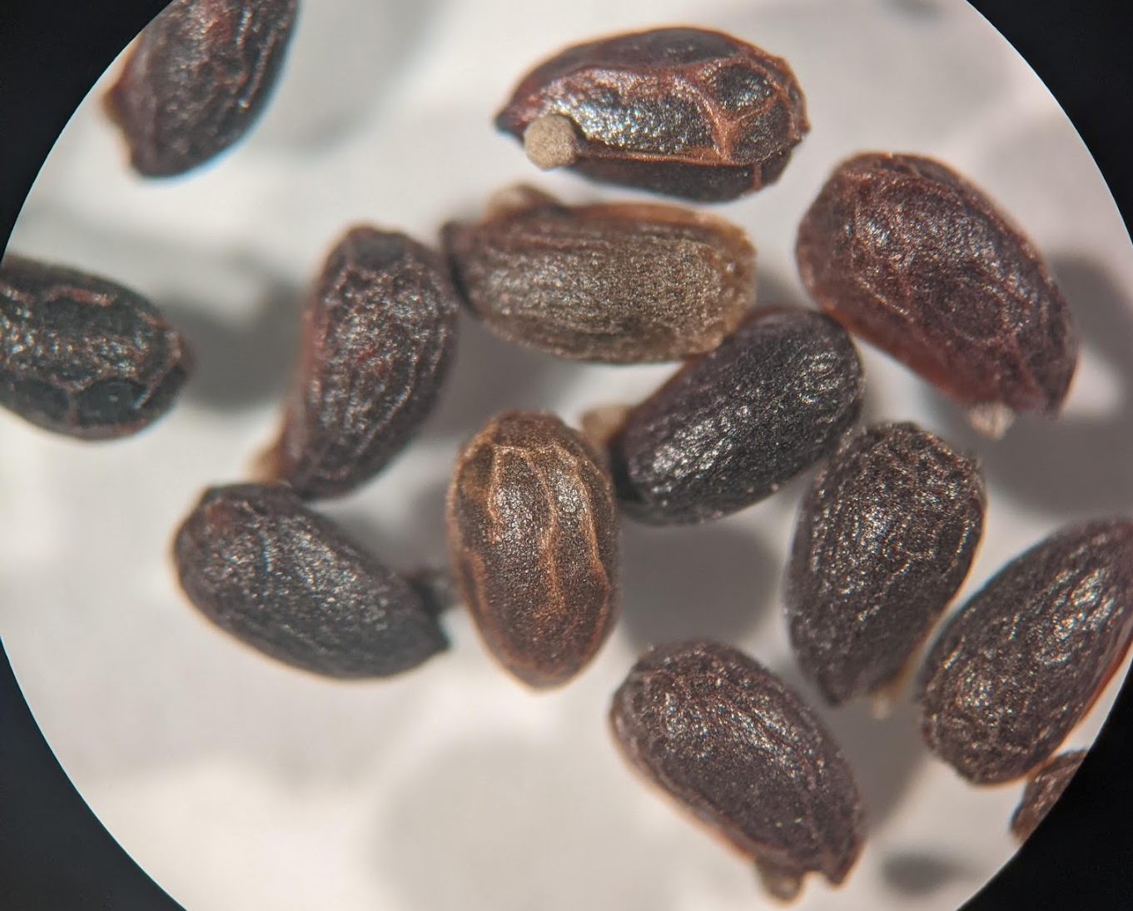
Methods of Scarification
Bio Scarification
  - Growth chamber for several months to promote the growth of mold on the seeds
Mechanical Scarification
  - Course sandpaper + mechanical shaker to agitate seed coating
Chemical Scarification
  - Concentrated Sulfuric acid soak to break down seed coating as much as possible without killing the seed
Similar to the movement of seeds through soil and rocks

Slide 7
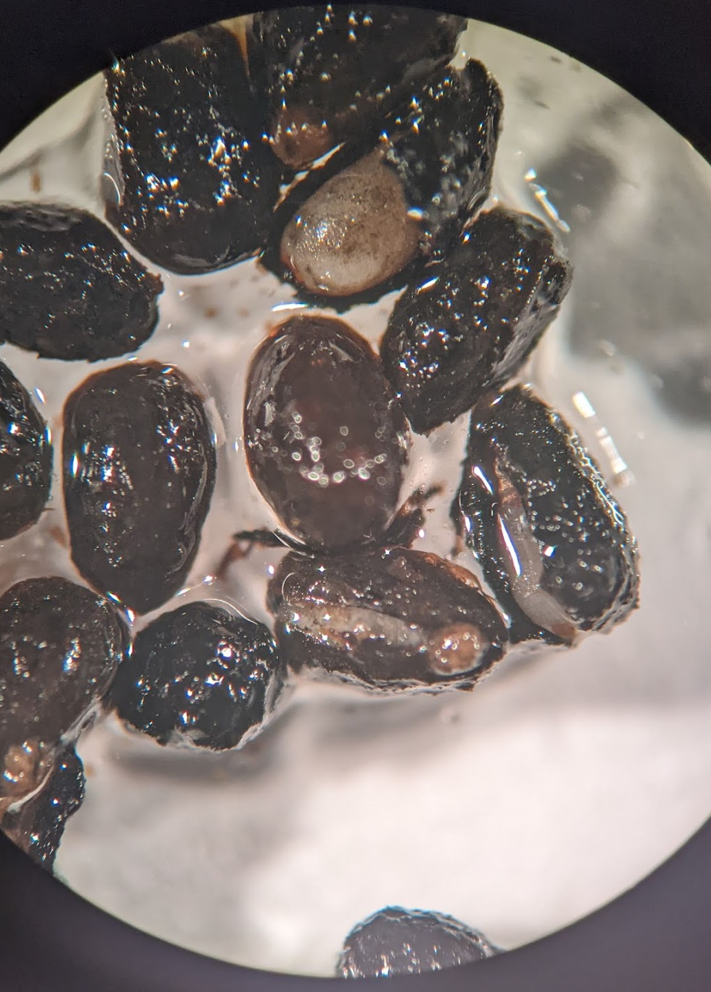
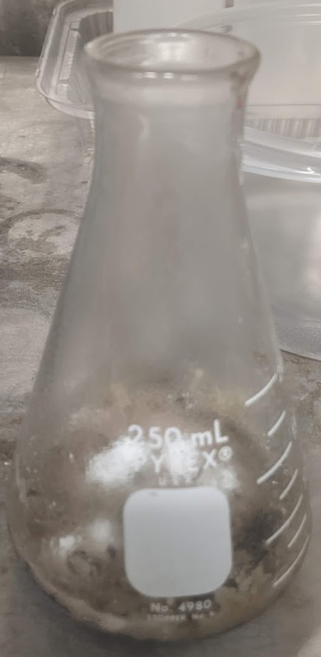
Methods of Scarification
Bio Scarification
  - Growth chamber for several months to promote the growth of mold on the seeds
Mechanical Scarification
  - Course sandpaper + mechanical shaker to agitate seed coating
Chemical Scarification
  - Concentrated Sulfuric acid soak to break down seed coating as much as possible without killing the seed
Replicates digestion through an animal's gut

Slide 8
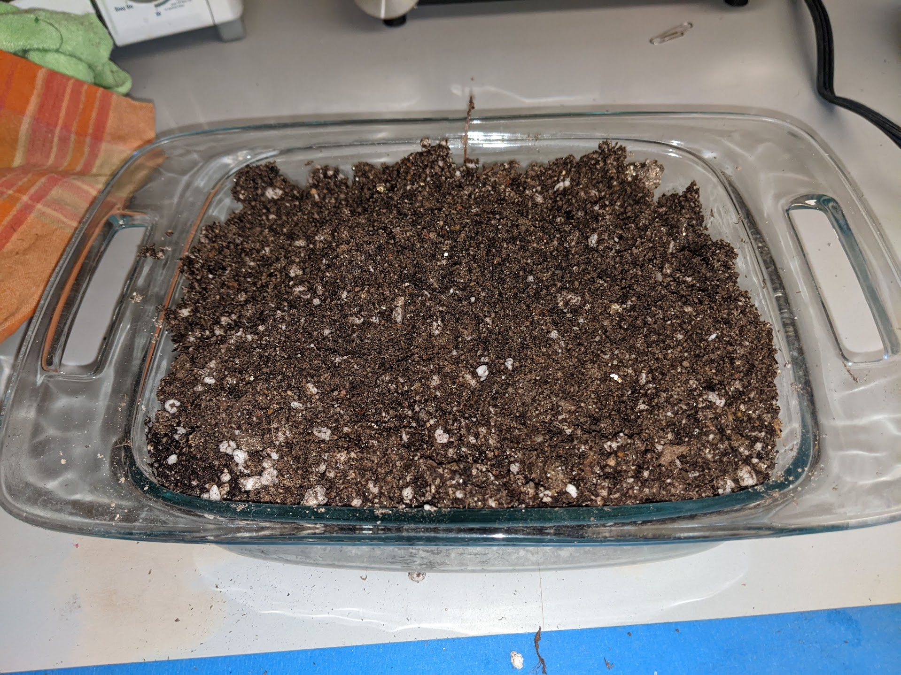
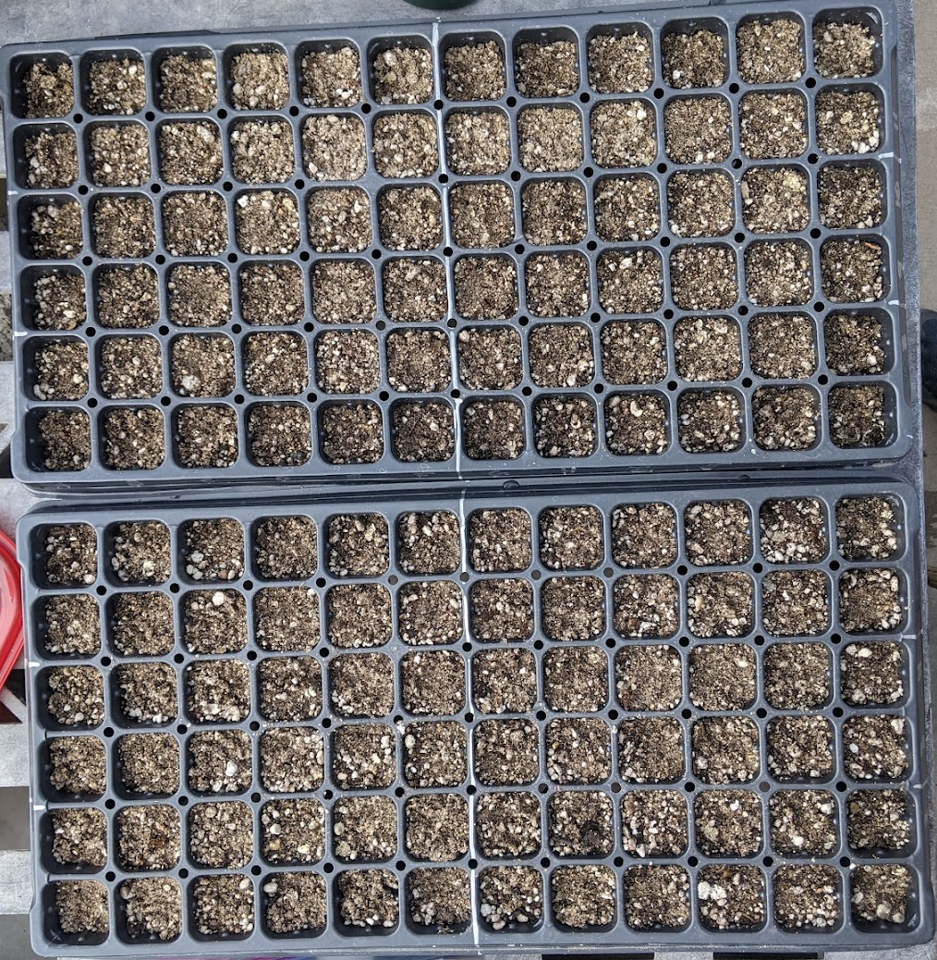
75 seeds from each collecting location used for each condition
Total sample size of about 2,700 seeds
(450 seeds/condition)

Slide 9
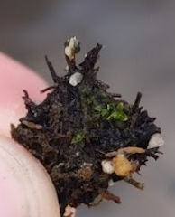
Results and Discussion
No growth!
Acid scarification had the clearest direct effects on the seeds
--> still no final results
Further research
More precise methods of scarification
Water and temperature trials
Gypsum and biocrust presence
Conservation efforts during times of climate change and an impending mass extinction event

Slide 10
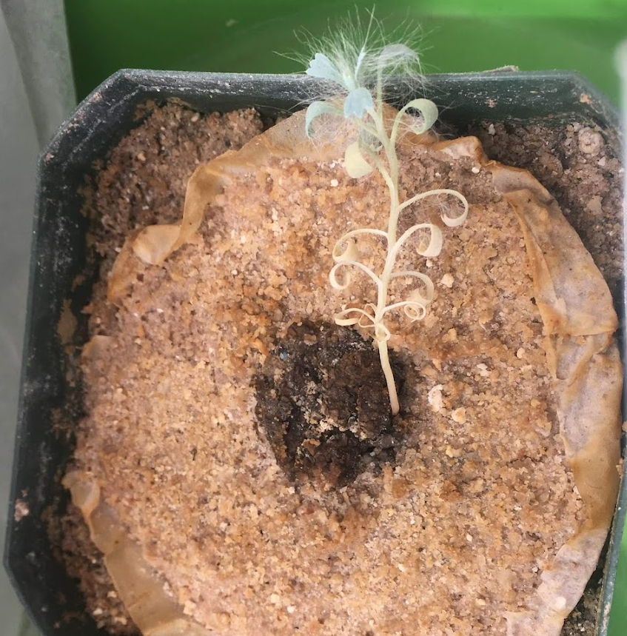
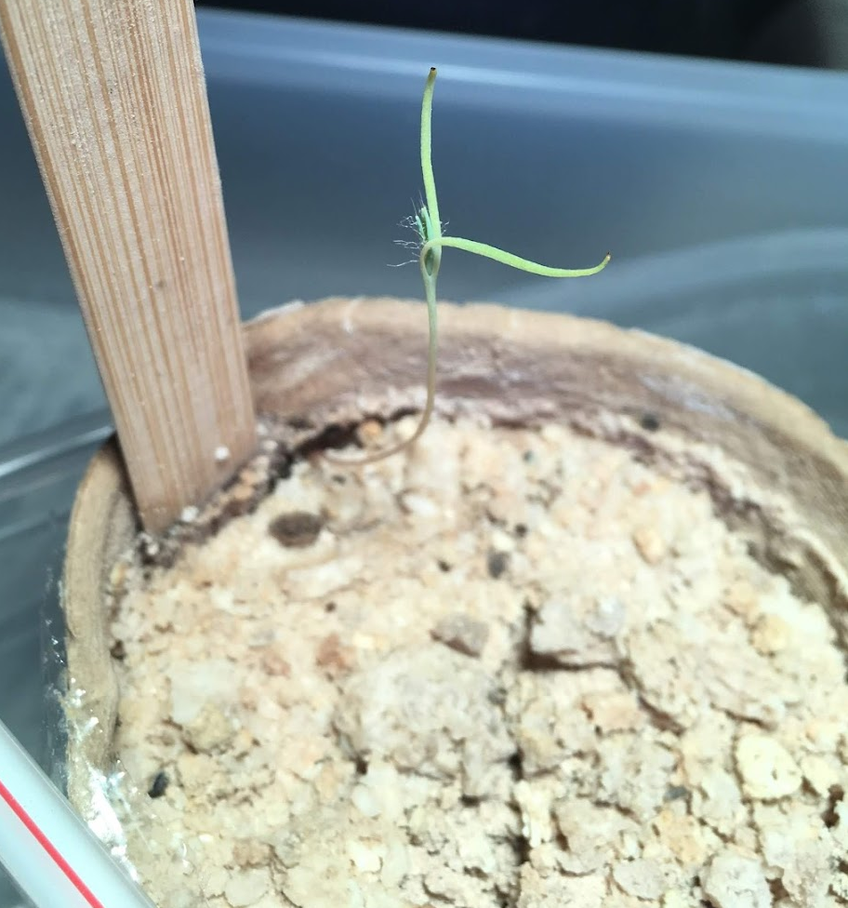
Results and Discussion
No growth!
Acid scarification had the clearest direct effects on the seeds
--> still no final results
Further research
More precise methods of scarification
Water and temperature trials
Gypsum and biocrust presence
Conservation efforts during times of climate change and an impending mass extinction event

Slide 11
Acknowledgments
Anita Antoninka
Lydia Bailey
Adair Patterson
NAU School of Forestry
Bureau of Land Management
Arizona NASA Space Grant

Slide 12
Thank You

